Slide 1
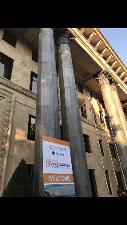
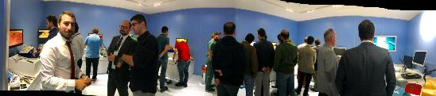
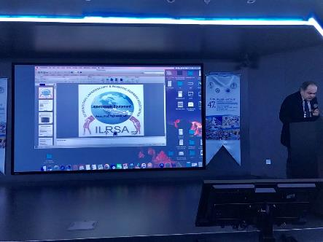
ILRSA Laparoscopy Training Program
Yasar Ozgok Professor MD.
Laparoscopic Training 2004-2022
What has changed?

Slide 2
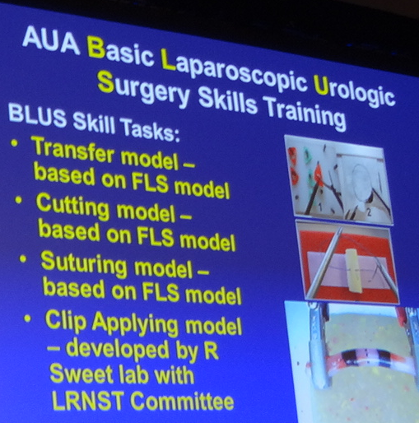
Laparoscopy Education Program

Slide 3
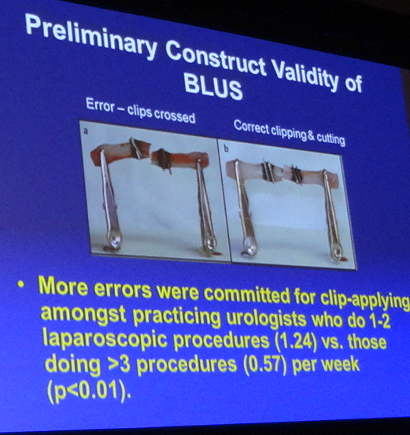
Laparoscopy Education Program

Slide 4
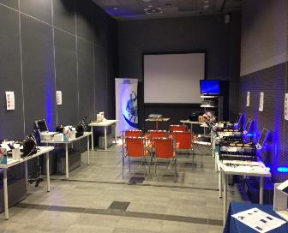
Laparoscopy&Robotic
Reality & issues
Finance
Manpower
Official contact and paperwork
Training material (standardization, copyright)
Endourologic Association Exam

Slide 5
“Simplicity is a difficult thing to achieve.”
Charlie Chaplin

Slide 6
Has to facilitate bringing education to urologists and standardizing the level of education to ensure a certain quality of training.

Slide 7
Long term Validation Programs
  Heilbronn training program (Rassweiler)
  Modular training (Stolzenburg)
  Belgium program
  BAUS(British association of Urologic Surgeons) program
  Society Endourology
  Japanese Endourology society

Slide 8
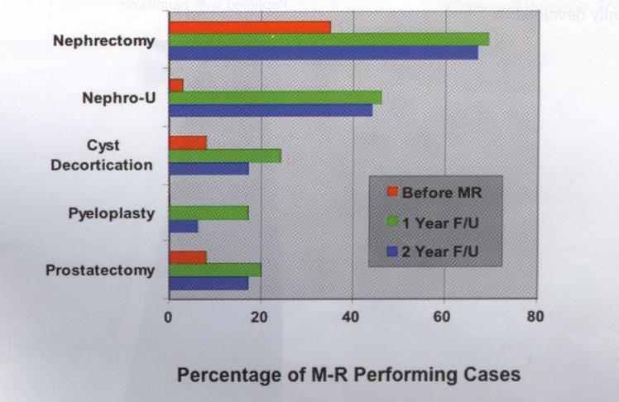
5 days Laparoscopy post training performance
(University of California, Irvine)

Slide 9
ILRSA Training Programs
Aiming urologists to apply laparoscopy effectively
Can be for long or short time periods
Regardless of time wasting
    training programs incorporating evidence-based training principles have the potential to produce excellent surgeons in a shorter time without compromising patient safety

Slide 10
ILRSA Short Term Courses
Short-term courses are the supporting stages in the acquisition of urological laparoscopy
Training would start with simulated models and clinical situations in the skills lab until predefined proficiency criteria are met
Only then would the trainee be able to progress to clinical situations on the ward and in the operating room

Slide 11
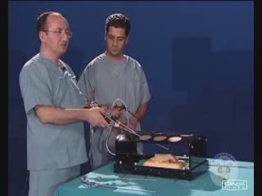
ILRSA Applied Laparoscopic
Urology Course
composed of three parts:
    exercise in training boxes,
    video presentations and lectures,
    performing live laparoscopic operations and hand on training on pigs in the animal research laboratory
    The number of participants is limited to 20-36 urologists for each course
    Since 2005, more than 750 urology specialists were provided laparoscopic urology courses

Slide 12
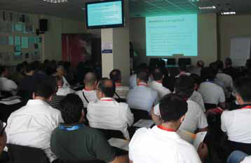
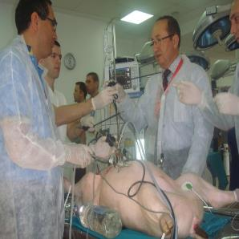
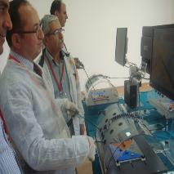
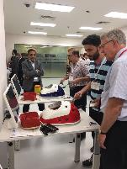
The trainees are divided into three sub-groups
    The first group
      participates in a video-based theoretical session
    The second group
      trains in the dry lab
    The third
      in the wet lab
Notes:
(It is very important to seperate trainees in to groups for the quality of education)

Slide 13
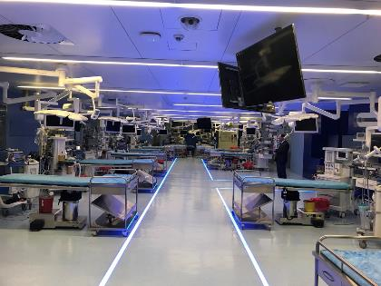
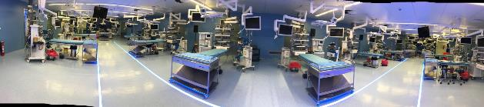
Wet Lab
(Animal Laboratory)
Experience with live model is identical with the real surgery

Slide 14
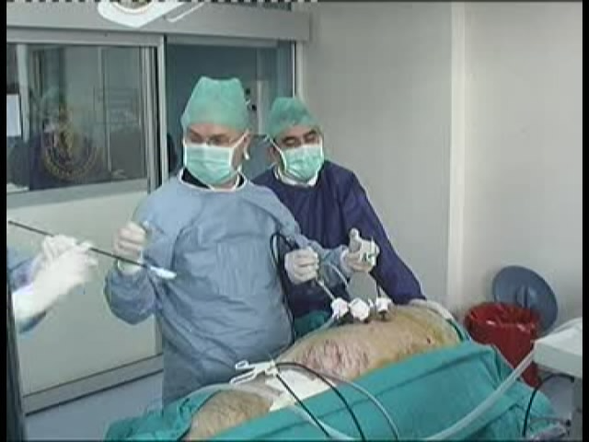
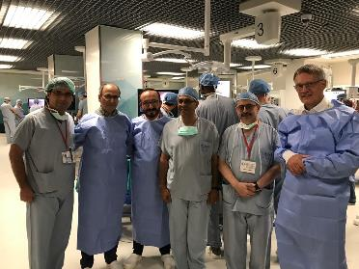
Wet Lab (Animal Laboratory)
Increasing laparoscopik skills with live animal models (especially with porcine)
    Watching each other
    Performing own live procedures

Slide 15
Applied Laparoscopic Urology Course
After four hours, the groups rotate and thus the first group proceeds to the dry laboratory after the video session
The second group to the wet laboratory where live animal surgery is conducted on pigs
The third to the video session
Each group has the opportunity to participate in the same field twice
dry lab
wet lab
video
session

Slide 16
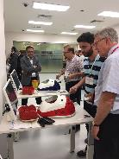
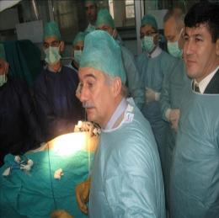
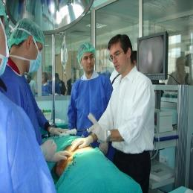
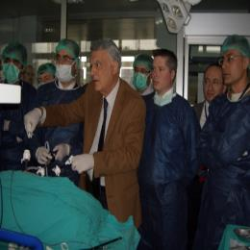
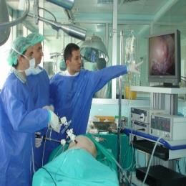
Animal Research Laboratory
Animal Research Laboratory is present where hands on laparoscopic urologic training on porcines are given
Fully equipped four operation rooms and competent personnel

Slide 17
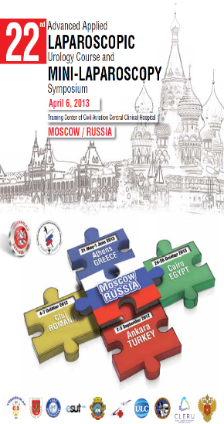

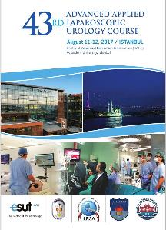
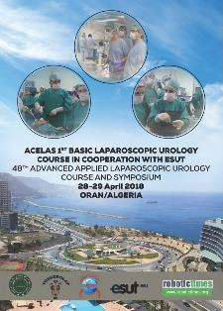
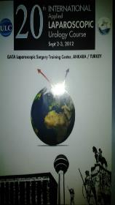
Beyond the Turkish trainees, we have provided laparoscopy training to the ones from other countries such as Rusıan ,Germany, Italy, Greece, Romania, Hungary,England, Kırgızystan, Egypt, Endoneysia, Uzbekistan and Azerbaijan
5 selected residents from ESRU HOT-course in Prag are accepted as trainees
We are planning to welcome more international trainees in our future courses

Slide 18

Beyond the Turkish trainees, we have provided laparoscopy training to the ones from other countries such as Germany, Italy, Greece, Romania, Hungary,Kırgızystan, Uzbekistan and Azerbaijan
5 selected residents from ESRU HOT-course in Prag are accepted as trainees
We are planning to welcome more international trainees in our future courses together with Endourology Society

Slide 19
Accreditation
The Ministry of Health of Turkey has accredited our courses since the 3rd course and currently our course is the only authorized course that can issue the certificate to the trainees
Additionally, our 3rd course was accepted among the sequential courses of EBU and acredidated with 24 points
Our courses are also considered as post graduate courses by the Turkish Association of Urology
Acredited by ESUT

Slide 20
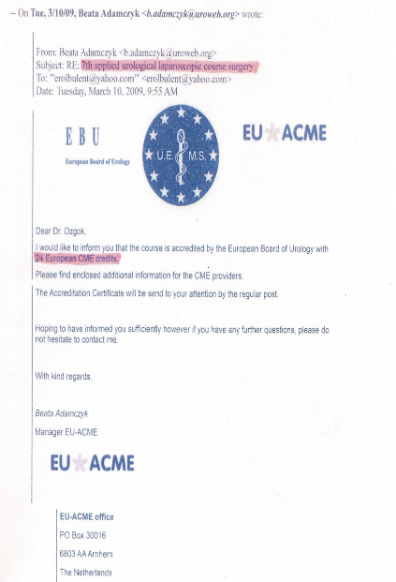
Accreditation
The Ministry of Health of Turkey has accredited our courses since the 3rd course and currently our course is the only authorized course that can issue the certificate to the trainees
Additionally, our 3rd course was accepted among the sequential courses of EBU and acredidated with 24 points
Our courses are also considered as post graduate courses by the Turkish Association of Urology
Acredited by ESUT
Notes:
Im proudly repeat it again, that All our courses were acredited by ESUT and EBU.

Slide 21
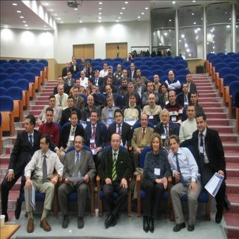
Trainers
The laparoscopy training to the course participants is given not only the Turkish laparoscopic urologists but also by the invited international urologists who perform laparoscopic urology in their countries such as Germany, Italy, Greece, Jordan England,Egypt, Azerbaijan and Romania

Slide 22
ILRSA laparoscopy training collaboration
Future training project :
Exchange of residents for training in laparoscopy centers
Ongoing scientific project in pigs supported by ESUT
WEB Page Education
E Journal

Slide 23
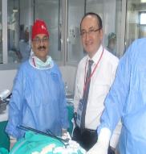
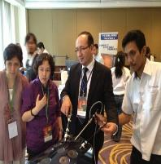
Turkish laparoscopy training collaboration
Future training project :
We set a very good communication and formed friendship among us in a very short period.
Then we increased this up to highest level possible with our colleagues who came from different countries such as Greece, Romania, Italy, Russia, Endonesıa, Germany, Hungary, Egypt, Azerbaıcan, Uzbekıstan, Kırgızıstan.Georgia, Jourdan, Algeria........
We created also an international trainer group consisting expert laparoscopic urologists.
Exchange of residents for training in laparoscopy centers
Ongoing scientific project in pigs supported by ESUT,
WEB Page Education
E Journal

Slide 24
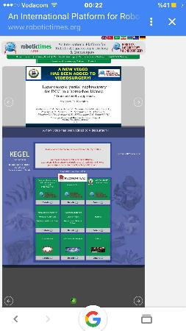
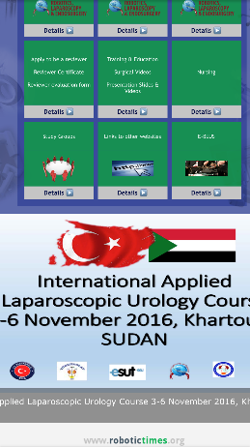
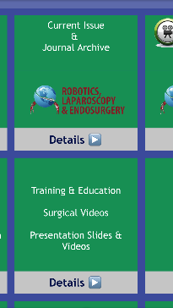
WEB PAGE
www.turkurolap.net
The history is to find at the web page of www.robotictimes.org Additionally, we are publishing an E-journal named “Robotics, Laparoscopy and Endosurgery” at http://www.robotictimes.org/ current_issue.php.
Language: English,German, Italy, Turkish, Arabic, Azerbaijan

Slide 25
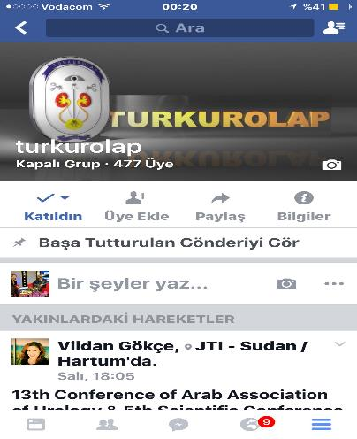
WEB Page
The history is to find at the web page of www.turkurolap.net
in Turkish, English, French

Slide 26
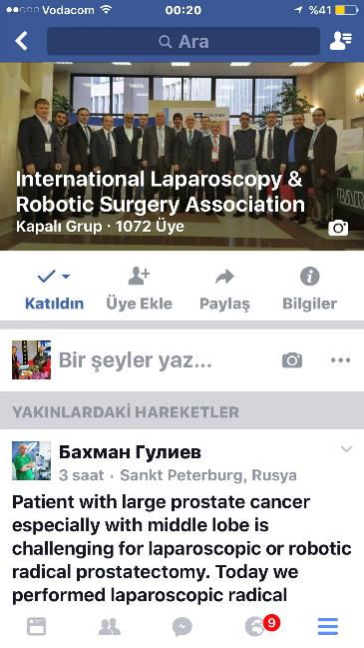
Comminication
Group
Our association has a facebook account :
(International Laparoscopy & Robotic Surgery Association Facebook) with over 1710 members, and is growing rapidly during the last two years.

Slide 27
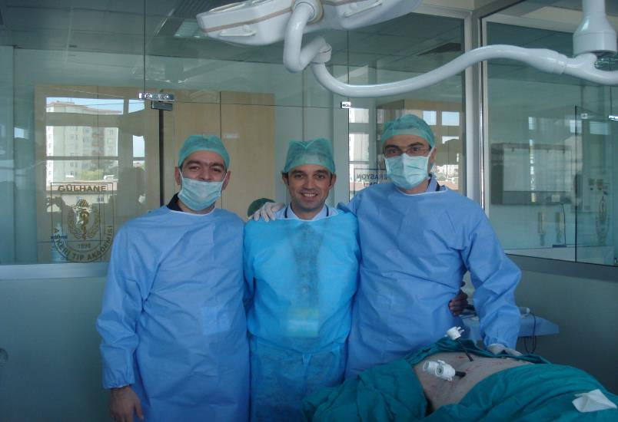
Greek residents train in 8th Laparoscopy course at Ankara

Slide 28
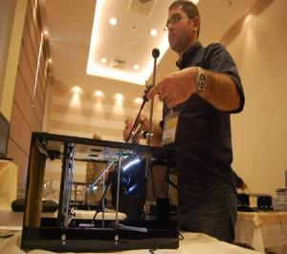
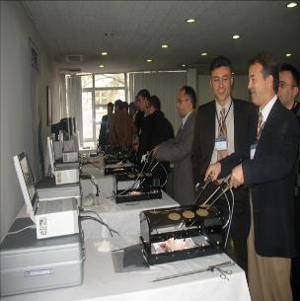
The trainees whom were trained in our courses have already started to perform actual laparoscopic urologic surgeries in the field of urology
Many of our first trainees from the previous courses now acted as the trainers in our courses and they also presented the videos of their own laparoscopic urologic procedures that they performed in their institutions
Therefore, we think that our courses have made a great contribution for the improvement of Laparoscopic Urology in the World, as well

Slide 29
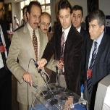
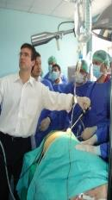
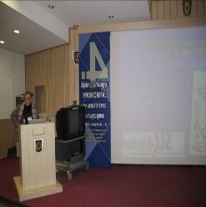
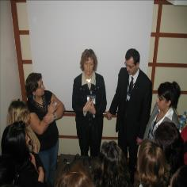
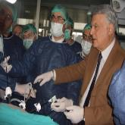
Symposium
Dr. Inderbir Gill
Dr. Anup Ramani
Dr. Jeffrey Cadeddue,
Dr. Peter Cuckow
Dr. Jens Rasweiller
Dr. Ali Gözen
Dr. Dogu Teber
Dr. Cloude Abbou
Dr. Günter Janetschek
Dr. Vito Pansodoro
Dr. Pilar Laguna
D. Jean de la Rosette
Dr. Paolo Fornara
Dr. Kevin Zorn
Mahesh Desai
In each course a one day symposium is organised with the participation of a worldwide known laparoscopic urologists who give lectures and also perform live laparoscopic procedures such as laparoscopic radical prostatectomy or laparoscopic partial nephrectomy

Slide 30

ILRSA
Nurse Laparoscopy Training Concepts

Slide 31
Course for operating theatre nurses
Courses aim:
  To identify the role of the nurse within the procedure
  To improve nurses’ knowledge on indications of laparoscopic surgery and its practical applications
  To raise awareness of specificities of laparoscopic surgery and improve knowledge in terms of the operating theatre equipment and new technologies, and how best to use them

Slide 32
Why training for nurses?
Laparoscopy is a teamwork and operating room nurse is an important part of this team who should be trained

Slide 33
COURSE OBJECTIVES
To improve knowledge on indications of laparoscopic surgery and its practical application
To teach techniques of maintanance and sterilization of laparoscopic instruments
To raise awareness of specificities of laparoscopic surgery
To improve knowledge of laparoscopic equipments, new technologies and how to use them
To identify the role of the nurse within the medical staff in order to improve the knowledge and skill of minimal acces surgery
To maintain knowledge of minimising laparoscopic complications
To maintain knowledge of laparoscopic postoperative care
To maintain knowledge of laparoscopic pre-operative preparation

Slide 34
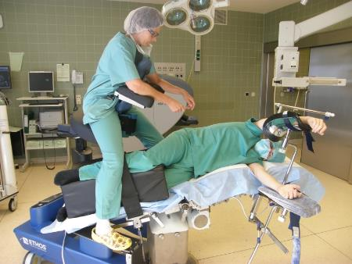
COURSE OBJECTIVES
TO PROVIDE SAFE
PATIENTPOSITIONING ….

Slide 35
Educational methods
Interactive theoretical lessons
Video sessions between faculty and course participants
Participating the procedures in wet lab and operating theatrE

Slide 36
Educational methods
Theory section:
Presentations and video projections:
  Introduction to laparoscopic surgery: history of laparoscopy
  Basic principles, cleaning, sterilization protocols
  The operating theatre, preparing patients
  Surgical equipments: description, cleaning and ways of use: insufflator, cold light source, camera, monitors, irrigation/suction device, electrosurgery.
  Laparoscopic instruments: graspers, hooks, scissors, instruments for ligature, clips and automatic graspers
  Single use disposable instruments / multiple use reusable instruments
  Principle of new equipments, robotics and NOTES

Slide 37
Educational methods
Practical section:
  Presentation and manipulation of various equipments, design, principle, ergonomics, and sterilization methods.
  Theory and "Hands On" practical demonstration on the table

Slide 38
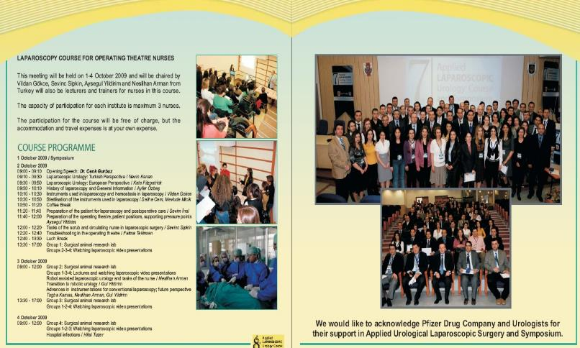
Nurse training program
Notes:
We know that nurses are an important part of the laparoscopy team.
38

Slide 39
Key topics
Scrub nursing in urology and preparation of operating room
Check list for surgical nurses
in the context of laparoscopic surgery
Urologic laparoscopic equipment

Slide 40
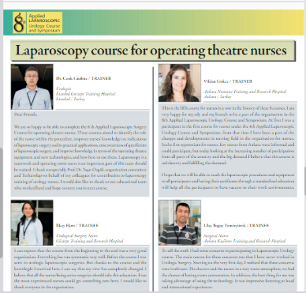
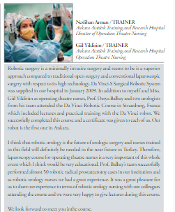
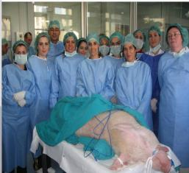
Nurse training program

Slide 41
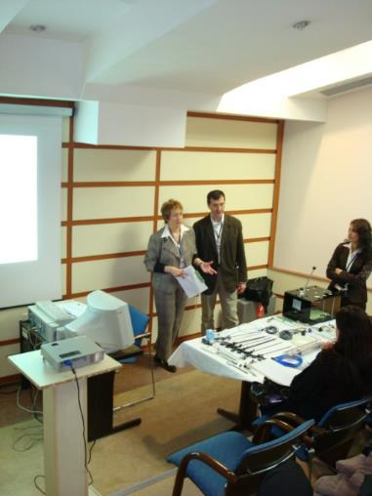
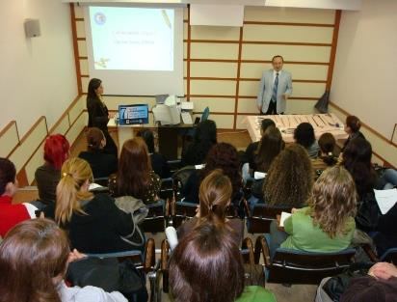
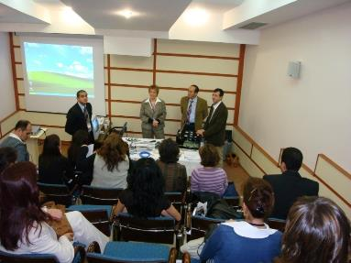

Nurses Attending Lectures
and Operations
Notes:
41

Slide 42
The comments of EAUN Board member Kate Fitzpatrick in “European Urology Today”

Slide 43



Slide 44

What we expect from Future
Close collobaration with Endo Urology Society
Accreditation of nursing training programme in Europe with EAUN and Endourology Society

Slide 45






Laparoscopic Training 2004-2022
What has changed?
The5th International Course and Workshop on advanced lapaeoscopic Urology
54h. Advanced Apllied Laparoscopic Urology Course and mini Laparoscopy Symposium,
21 E Blus- Hans on training course
2016-2017 2018
2019
2020
2022
2012
2004
2013
Notes:
1 am very happy to say that A lot of things have been changed in Turkurolap Laparoscopy Training
As you may know , the very first training started in Ankara in 2004 and we aimed to move our activities to other cities and We held the 8th one in Konya and then we decided to make this courses international , therefore the 10th one was held in Greece.
20th course was held as part of 30th World Congress of Endourology in İstanbul.
22th course is now in Moscow as ESUT course. We will succesfully continue these courses in Ankara, Cluj and Cairo in 2013.

Slide 46

Then We Used the international ones such as Greece , Romania
Then We Used the international ones such as
European Surgical Institute

Slide 47

Accreditation
The Ministry of Health of Turkey has accredited our courses since the 3rd course and currently our course is the only authorized course that can issue the certificate to the trainees
Additionally, our 3rd course was accepted among the sequential courses of EBU and 7th course acredidated with 24 points
Our courses are also considered as post graduate courses by the Turkish Endourology Society and Turkish Association of Urology
The 22th course is the first official ESUT course.
Notes:
Im proudly repeat it again, that All our courses were acredited by ESUT and EBU.

Slide 48
Selected residents from European countries also attended our course through ESRU
One page is reserved for our course in the september issue of the European Urology Today
Notes:
let’s look at chronologically at what level we are in the world so far

Slide 49
The comments of EAUN Board member Kate Fitzpatrick and Dr. Maksudhan Rashidhov from Tashkent in “European Urology Today”

Slide 50

We are able to work together in collaboration effectively

Slide 51





Meeting of laparoscopy sections in Athens , Endoneysia, Romania,Hamburg,Rusian etc.
Notes:
In the slaysts, you see some pictures of our courses that we conducted so far

Slide 52







Slide 53

Evaluation of Applied Laparoscopic Urology Course
Using Validated Checklist

Slide 54


Greek and Russian residents trainee in 8th Laparoscopy course at Ankara
Notes:
We believe that International collaboration was very important fort the succes of our courses.

Slide 55
Greek and Russian residents trainee in 8th Laparoscopy course at Ankara
Notes:
We believe that International collaboration was very important fort the succes of our courses.

Slide 56


Laparoscopy operation in Greece

Slide 57



Laparoscopy Course in Endoneysia

Slide 58



Laparoscopy operation and course in Romania

Slide 59

continue our successful partnership increasingly in laparoscopic training

Slide 60



Slide 61




Exercises
1. Peg transfer
2. Cutting a circle
3. Needle guidance
4. Single knot tying

Slide 62
Assessment
Scoring of 4 exercises with time (cut-off) and quality (errors) criteria
General performance score, 3 aspects: depth perception, bimanual dexterity, efficiency
Certificate (or not): recommendation to continue training in OR
Personal training advice

Slide 63
Exam procedure (1)
Explain procedure to examinee
Explain correct performance of each exercise
Exercise explanation sheet
Before each exercise 1 minute practice, without destroying material, help from tutor allowed
During exercise no help from examiner, except changing instruments

Slide 64
Exam procedure (2)
2 chances to pass each exercise
Record all time and quality scores, for each trial of each exercise, archive products
Exercise stopped when failed (+15-30 sec)
Exam stopped when failed
General performance observed over all exercises
Finally personal training advice

Slide 65
Administration
Record examinees name on DVD
Record exam in one take on DVD
Archive final products (mark Trial 1 or 2)
Scoreform
Record all data available for continuous evaluation

Slide 66
Exercises
 | Target times Min:Sec | Start time | Stop time | Quality Criteria Each 1 point | Quit Trial Min:Sec
Task 1 Peg Transfer | 2:06 | First object touched | Last object fallen | No dropped objects | 2:25
Task 2 Cutting Circle | 2:31 | First cut | Circle comes loose | No cut beyond the lines | 2:50
Task 3 Needle Guidance | 4:28 | Enter ring 1 | Needle passed ring 10 | - | 5:00
Task 4 Knot Tying | 6:00 | Needle into rubber | Suture has been cut | Stitch within 1 mm of mark Correct approximation No slipping knot | 6:30

Slide 67
General performance
Scale 1 – 5 To pass: each aspect score 3 or higher
Depth perception
1= Constantly overshooting target, hits backstops, wide swings, slow to correct
3= Some overshooting or missing plane, but corrects quickly
5= Accurately directs instruments in correct plane to target
Bimanual dexterity
1= Use of one hand, ignoring non-dominant hand, poor coordination between hands
3= Use of both hands, but does not optimize interaction between hands to facilitate conduct of exercise
5= Expertly uses both hands in a complementary manner to provide optimal working exposure
Efficiency
1= Uncertain, much wasted effort, many tentative motions, constantly changing focus of exercise or persisting a task without progress
3= Slow but planned and reasonably organised
5= Confident, efficient and safe conduct of operation; maintaining focus on component of procedure until better done by another approach

Slide 68
Our wishes,
1- If it is possible, we would like to wish that ILRSA (International laparoscopy and robotic surgery association) would be affiliate with Helenic Urological Association of Urology HAU, Jourdan Associotion of Urology JAU, (Algerian Endourological Society (ACELAS) Russian …....
2- Meanwhile, we would like to see that some of the trainers of our group would be listed in the SIU trainers and UTT
3- I would like share our team experience with you in duration of all courses’ plans worldwide.

Slide 69

Finally, we would like to common points that we have with the harmony of science and friendship,
Notes:
The 22th course is now in Moscow, this is very important, because this is the first official ESUT course.
Our upcoming planned courses in this year will held in Athens (23), Cluj (24) and Cairo(25).
We believe that International collaboration is very important for the success of Applied Laparoscopy courses,

Slide 70







Slide 71



Thank You

